Slide 1
Look listen learn
Team femsinSTEM

Slide 2

Who are we?
Hi!
We’re team femsinSTEM, from Queens College.
Our project is called ‘look listen learn’ or triple L! It’s a website designed to provide individuals struggling with mental health issues with material, educational, financial and medical resources.
We aim to target various groups of individuals including, but not limited to: domestic violence victims, sexual assault victims, recovering veterans suffering from PTSD and individuals suffering with suicidal thoughts or tendencies.

Slide 3




How did we design this?
We made various drafts of our ideas before deciding on our overall theme.
We used HTML, Java, Google Cloud Platform and PayPal API’s in our project in an attempt to not only explore new platforms but also make this project as progressive and innovative as possible.
We wanted to assure the user had a calming experience without feeling intimidated so we made our contexts and our user experience as friendly as possible. We used stereotypical ‘calming colors’ and formatted any dialogue in a more friendly then professional manor.

Slide 4

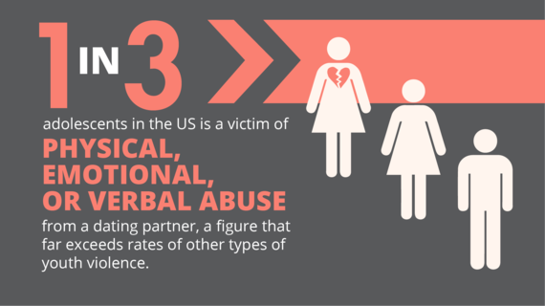
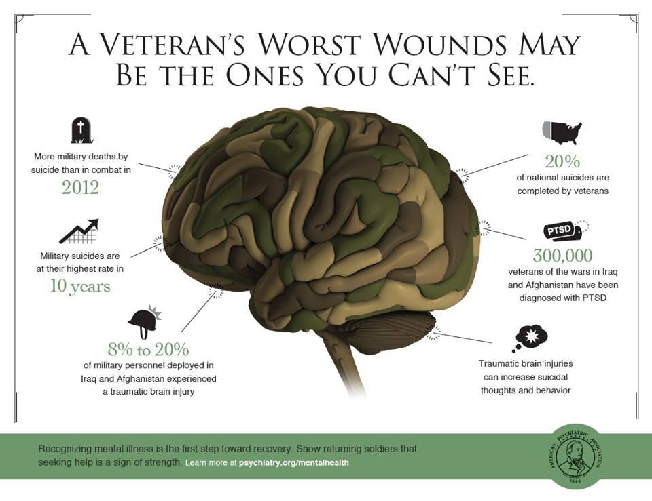

Why this project?
We’re all coders. But we were all kids once and we wanted nothing more than to be superheroes and change the world for the better. Computer science allows us to do that and ergo, fulfil our dream.
With the amazing revolutions taking place these last few years more and more women are being encouraged to enter the STEM fields and speaking up for their rights. Because of this, we felt a need to give others the opportunity to make a better life for themselves as well.
But, this has to start small, from making sure they have food in their stomachs to providing free, online consultations and resources we aim to help anyone struggling with mental health issues of any kind to seek help and become their very own superhero.

Slide 5
Challenges?
The biggest challenges we faced throughout this project were the gathering of plenty of reliable and accurate resources. The most important aspect for us was to offer a variety of services as simply as we could.
Communication was KEY to this. We made sure the work was divided accordingly to everyone's strengths and weaknesses and everyone was allowed to add their own creative input to the project.

Slide 6
Some of our special touches?
* Search History Erased: We wanted to make sure that our user didn’t feel hesitant towards using our service because they feared someone might view their search history. We believe that the most important thing is for these people who struggle to motivate themselves to seek help.
* Quizzes: We designed two set of quizzes, one for victims and one for the general population. Each quiz was created using Google Forums and the responses to these questions are recorded and can be used for research purposes. The questions vary from personal feelings and history to specific scenarios, to statistics that may seem to be false but are sadly true.
* User Friendly: this was our main focus. We wanted to make our website more then just a national page with a hotline and a chat. We wanted to offer more so we incorporated various design elements to make it as if you didn’t even know what page you were looking at.

